Slide 1
Week 9 Project Presentation

Slide 2
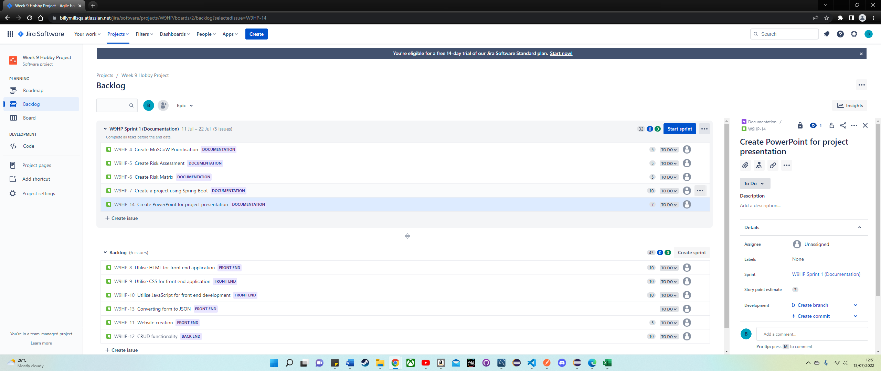

Slide 3
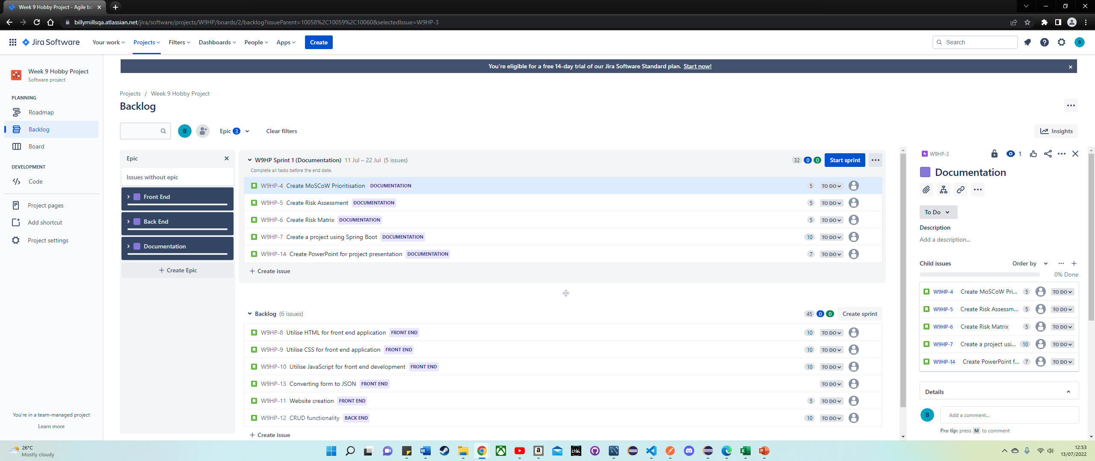

Slide 4
